Slide 1



Project on Supply Chain Analytics To analyze supply chain operations and monitor key performance indicators (KPIs) for better decision-making.

Slide 2

Key Performance Indicators (KPIs)
Total Orders : 12,000
Total Sales Revenue : ₹19,39,92,801
Total Shipping Cost : ₹16,22,595
Average Delay Days : 1.46
Average Order Value : ₹16,166
Forecast Accuracy : 94%
On-Time Delivery : 66%
Fill Rate : 95%

Slide 3

Manufactured vs Rejected Quantity
Comparison between produced and rejected quantities
Helps identify production efficiency
Rejection % indicates quality performance

Slide 4
Department-wise Performance
Footwear
Knitwear
Printed Fabric
Woven Labels
Compare production vs rejection across departments

Slide 5

Monthly Production Trend
Production data from Jan to Dec
Identify peak and low production months
Useful for planning and forecasting

Slide 6
Production vs Rejection Rate Trend Analysis
Line chart showing production vs rejection %
Helps track quality over time
Identify months with higher rejection

Slide 7
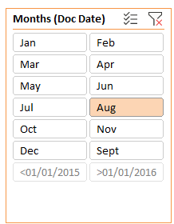
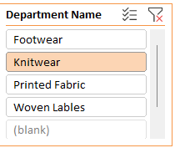
Dashboard Filters
Department Filter
Monthly Filter
Enables dynamic analysis

Slide 8

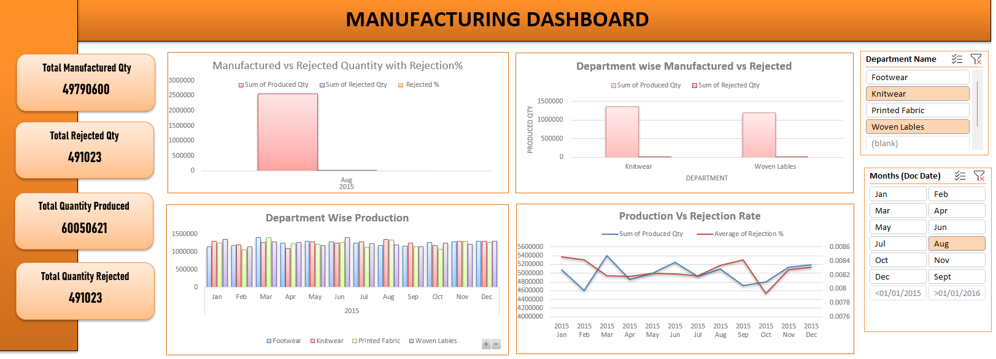
Manufacturing Dashboard

Slide 9
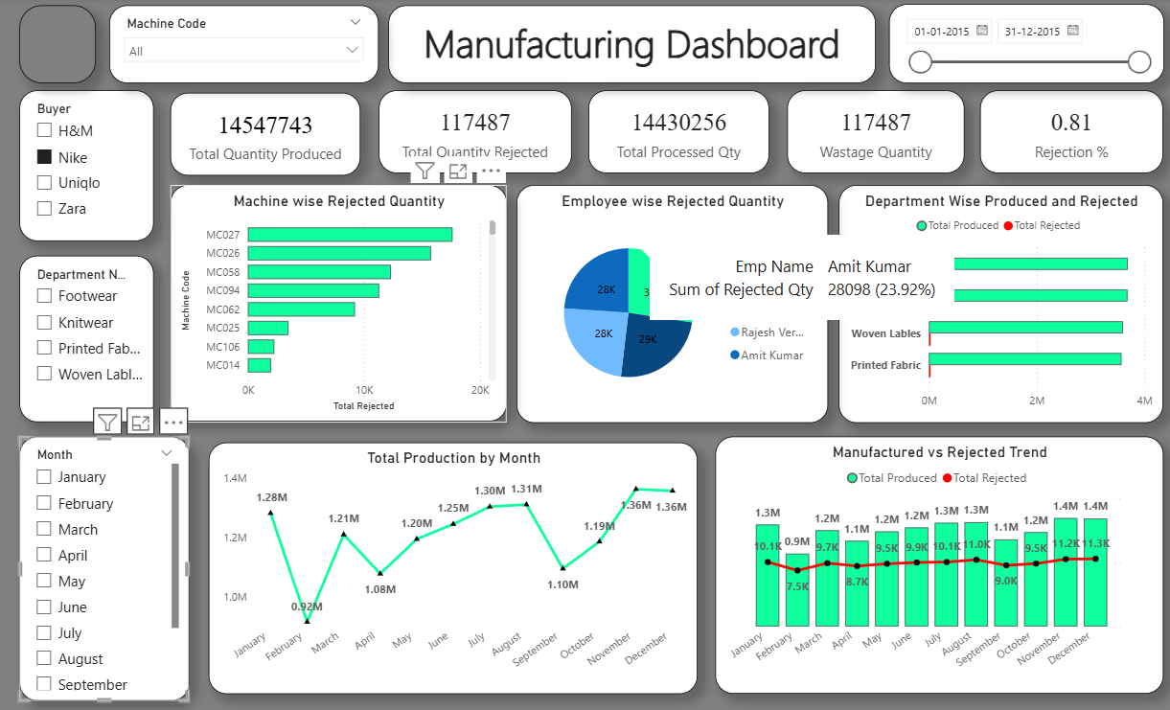
Manufacturing Dashboard

Slide 10
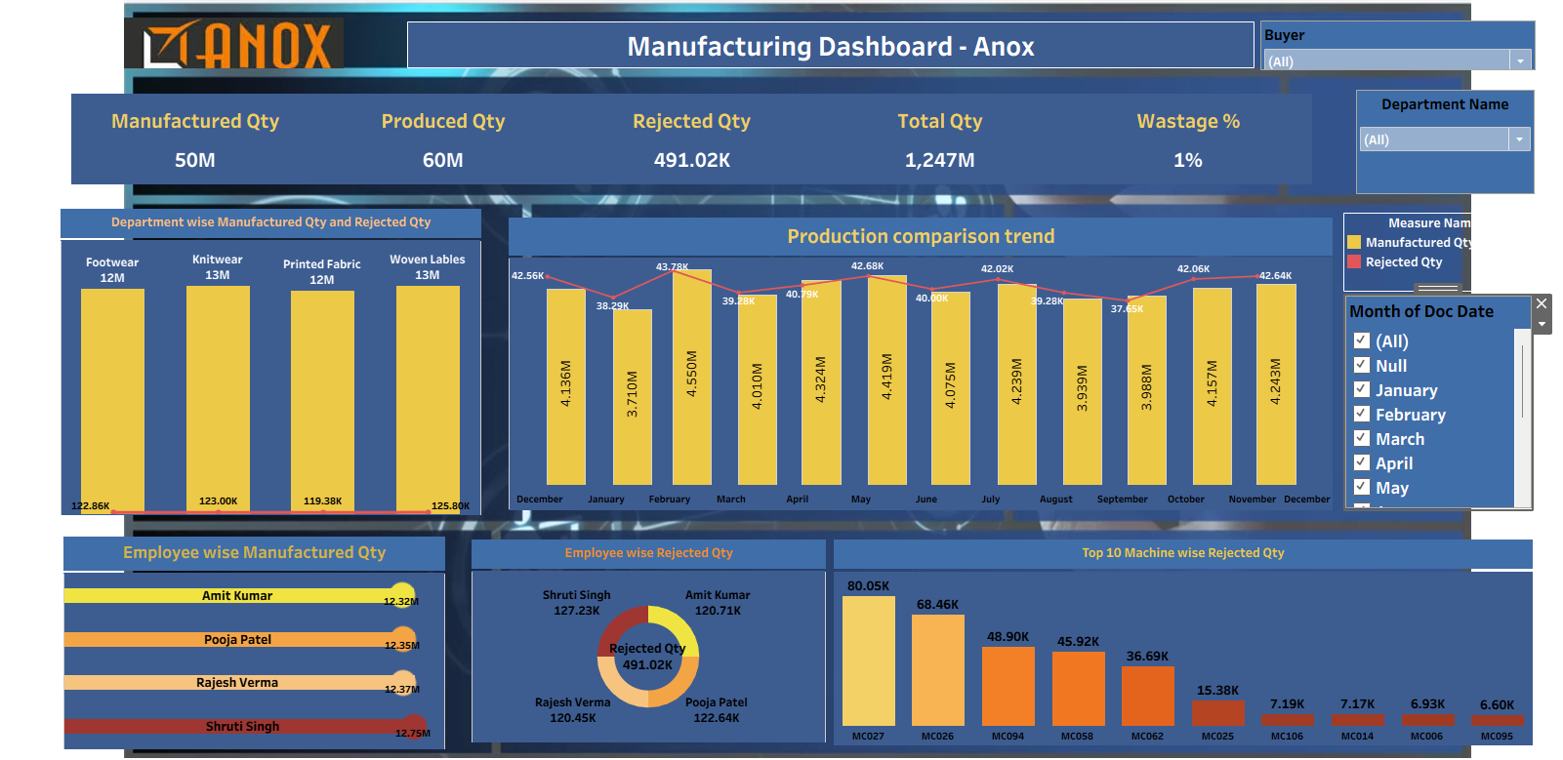
Manufacturing Dashboard
Thank You

